Slide 1
Market Position & Share Analysis

Slide 2
AGENDA
1
Problem Statement
2
Overview
3
Various segments of revenue
4
Strategic Segment Mastery vs. 2025 Retention Challenges
5
Key findings after analysis
6
Executive Summary and Conclusion

Slide 3
PROBLEM STATEMENT:
As a key stakeholder, there was a need to gain a clear and objective understanding of the company’s true market position.
Existing internal reports lacked visibility into critical market-level indicators, including:
The total addressable market and how many customers had been captured.
The number of active customers, defined as customers generating Last Twelve Months (LTM) revenue greater than zero.
The company’s share of total market revenue.
This raised concerns that revenue growth alone does not necessarily reflect market strength, competitiveness, or long-term sustainability.

Slide 4
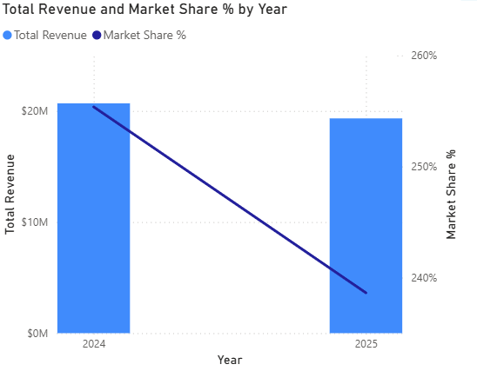
Overview
$40.01M
Current Revenue
890
Active customers
Our company is managing 890 active accounts with a premium average value of $44.9K per client.
Despite a solid $40M revenue base, we are facing a 6.55% annual decline driven by a $20M churn leak, primarily within the Healthcare sector.
Our strategic roadmap targets a $53M revenue goal and a 6% market share by aggressively reactivating inactive accounts and capturing high-value growth opportunities.
Notes:
Instructions:
Replace with photos, names and specific project roles of team members
Edit to include any additional details, e.g. if additional team members will be onboarded later
Add or remove cards as needed
Example slide in appendix

Slide 5
Various segments of revenue
Industry Types
Regions
Healthcare (Critical Risk) | Our largest sector, but currently the most volatile. It holds the highest churn leak of $4.9M.
Manufacturing (Strategic Core) | A stable high-value segment with a churn risk of $3.9M, requiring defensive retention strategies.
Retail (Growth Opportunity) | Currently facing a $3.8M churn, but identified as a key area for high-value account recovery.
Finance & Technology (The Anchors) | These are our most stable industries. While they still face some churn (~$3.7M), they show the highest ARPU resilience and are the primary targets for our $1.8M offensive growth pipeline.
The "South" Dominance | Total Revenue: $10.57M This region likely contains your most loyal "Enterprise" clients. It is the best place to pilot your upselling strategies because the relationship trust here is the highest.
The East: High-Value Growth Hub | Total Revenue: $9.87M It generates nearly as much as the South but potentially with a smaller team or lower operational costs. It is the benchmark for regional productivity.
The North: The Resilience Sector | Total Revenue: $9.85M Because the performance is so consistent (only a 0.2% difference from the East), this region represents your "Proven Market." It is resistant to volatility and provides the most predictable quarterly forecasts.
The West: The Untapped Potential | Total Revenue: $9.73M Don't view this as a "weak" region; view it as your biggest expansion opportunity. Because it is already hitting 120% efficiency, adding more resources (Sales/Marketing) to the West could yield the fastest return on investment to help hit that $53M total goal

Slide 6
Comparing the revenue over time
2024 Baseline:
2025 Value Slide
The business maintained an average account value of $22,507. Stability was the primary characteristic of the top-tier base.
The business was effectively the "Baseline." The performance was stable, and the growth metrics were positive as you built the $40M foundation.
ARPU dropped to $21,717 (-3.51%). This indicates a dilution of account value alongside customer churn.
We hit the -6.55% annual decline . The data shows a "Volume Leak" where accounts are closing faster

Slide 7
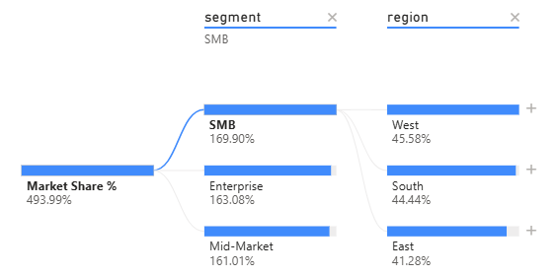
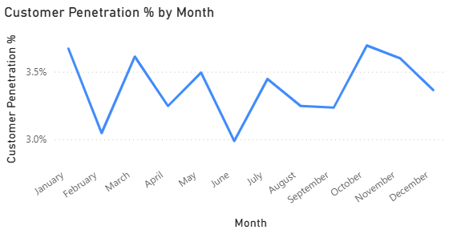
Strategic Segment Mastery vs. 2025 Retention Challenges
Winning: Our high-value model ($45K ARPU) is stable.
Losing: We have lost 45% of our customer volume in the last 6 months.
Action: We must pivot from 'Acquisition' to 'Retention' immediately to hit the $53M target.

Slide 8
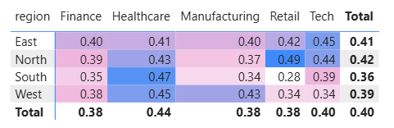
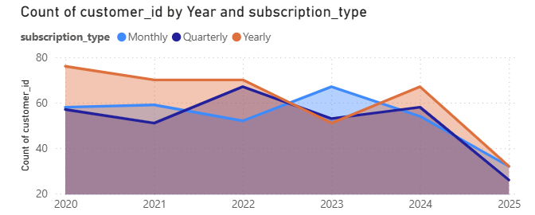
Strategic Segment Mastery vs. 2025 Retention Challenges
The heatmap highlights that Healthcare is the strongest industry performer (0.44), while the North/Retail and South/Healthcare cells show the highest localized penetration.
The area chart reveals a critical collapse across all subscription types in 2025, with Yearly, Monthly, and Quarterly counts all converging at their lowest historical levels.

Slide 9
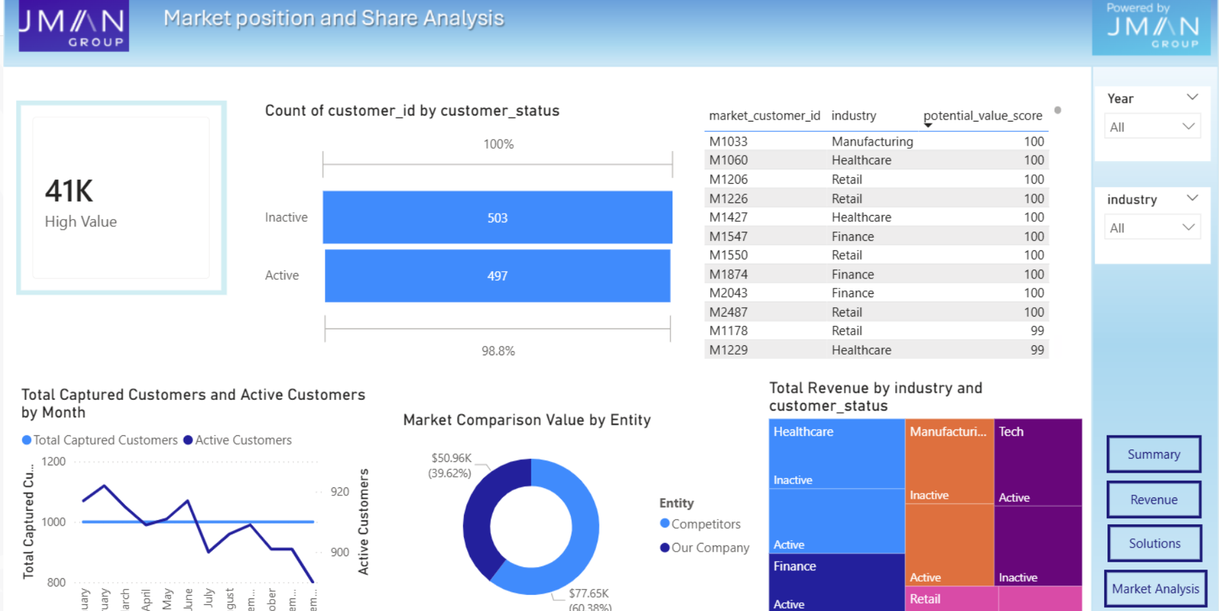
Key findings after analysis
The various graphs below show that we need to increase the customer count to move to a better position in the market.
Value Scores
It shows the overall value scores that we are losing from the other market customers
This table shows the list of customers in the market with higher potential value score who can be attracted to our business .
Customer status
The number of Active customers is lesser than the number of inactive customers
It shows the proportion of active vs inactive customers based on the revenue earned, industry type , etc
Active customers
The active customers is decreasing , whereas the captured customers count is same which should be improved
Comparison
The company is compared with the rest of the market competitors based on the value score

Slide 10
Areas of Improvement – Analysis Results
Current Issues
Solutions
Average Revenue Per User (ARPU)
In 2025, the value dropped to $21.7K (a 3.51% decrease). This indicates that the customers who stayed are either downgrading their plans or demanding discounts, leading to "Internal Contraction."
To reverse the 3.51% contraction in account value, we must transition away from broad discounting. We will introduce Value-Added Service Bundles (such as advanced analytics or premium support) that justify a return to 2024 pricing levels.
By shifting the conversation from "price" to "ROI," we can stop the internal contraction and encourage existing clients to expand their commitment, moving the ARPU back toward the $22.5K baseline.
High Seasonality & Penetration Dips
The monthly penetration data shows extreme volatility, with sharp "valleys" in February and June.
This suggests an inconsistent sales cycle or a "churn-heavy" acquisition model where new customers join but don't stay past the first quarter.
This makes quarterly forecasting nearly impossible for the executive team.
To solve the February and June penetration valleys, we will move the customer base from Monthly to Annual Subscription Models.
We will offer a "Strategic Partnership Discount" (e.g., 10% off for a 12-month commitment) to eliminate the month-to-month churn.
Customer Churn
The most critical issue is that your customer count is falling significantly faster than your revenue.
While revenue dipped by 6.55%, the customer volume dropped by nearly 45% heading into 2025.
To counter the 45% drop in customer volume, we must move beyond just "landing" accounts and focus on "expanding" them.
We will implement a Customer Success Tiering Model that provides dedicated account management for our high-value Enterprise clients

Slide 11
Executive Summary
A Portfolio at a Crossroads
Identifying the $20M Churn Leak
The Path to $53M
Your organization maintains a high-value foundation with $40.01M in total revenue and a commanding 494% market share relative to assigned targets.
However, this stability is being tested by a -6.55% annual revenue decline and a sharp 45% contraction in customer volume.
While our core Enterprise relationships remain healthy—maintaining an average account value of nearly $45K—the broader market base is eroding, leading to a "top-heavy" revenue structure that increases our vulnerability to individual client exits.
Our audit has pinpointed the primary driver of this decline: a massive $20M churn leak heavily concentrated in the Healthcare and Manufacturing sectors.
Specifically, the Healthcare vertical alone accounts for a $4.9M revenue gap.
This loss is compounded by a 3.51% slide in Average Revenue Per User (ARPU) during 2025, suggesting that existing clients are facing pricing pressures or downgrading services.
Furthermore, high seasonality in February and June reveals a reliance on short-term commitments that jeopardize long-term stability.
To achieve our "North Star" goal of $53M in revenue and a 6.0% market share, we must pivot from a defensive posture to a dual-track recovery plan.
This involves an immediate "Win-Back" initiative for high-potential Healthcare accounts and a structural transition from monthly to annual subscription models to eliminate seasonal volatility.
By optimizing our marketing spend toward high-value acquisition channels and aggressively expanding in high-efficiency regions like the West, we will stabilize our volume and reclaim our growth momentum.

Slide 12
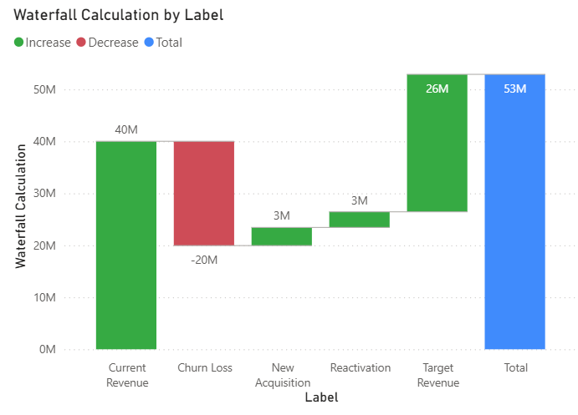
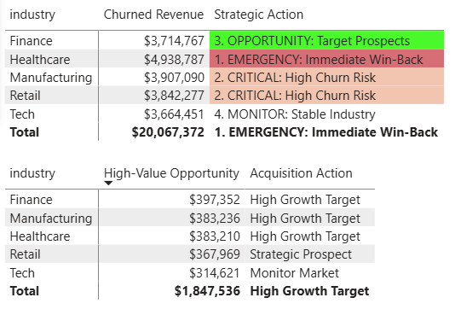
Conclusion
We can implement a high-velocity recovery plan that targets the $20M churn leak through aggressive Healthcare "Win-Back" campaigns.
By reallocating resources to high-efficiency regions like the West and optimizing marketing spend toward high-value acquisition channels, we will stabilize our customer volume and secure the path to our $53M revenue milestone.
The action to be taken for reducing the churn revenue
The projected revenue that could be achieved when the provided solutions are carried out .
The action to be taken for acquire the new high value opportunity

